Slide 1
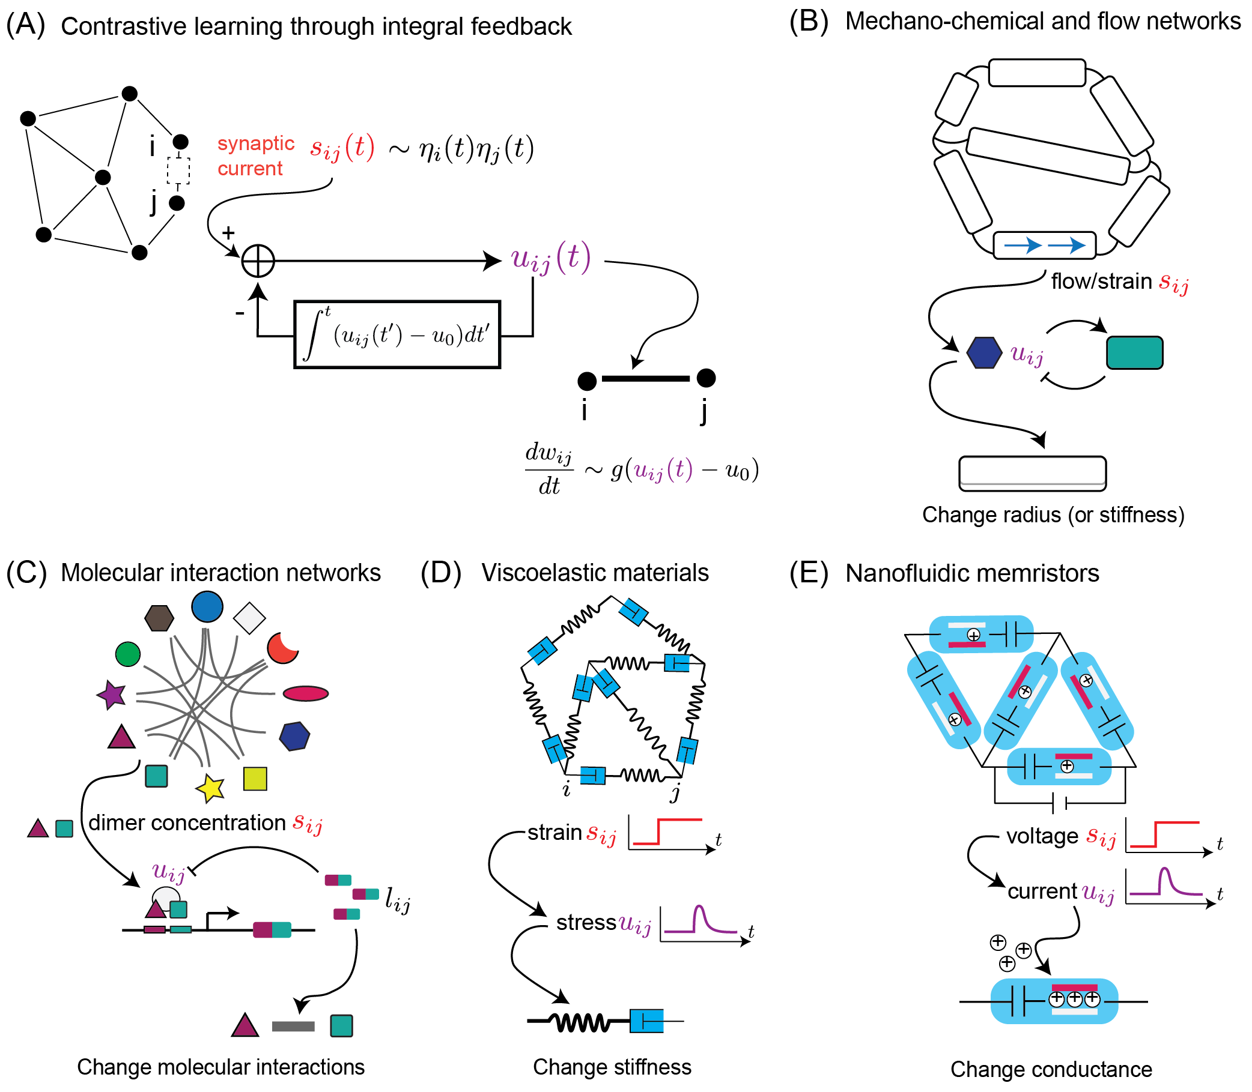
Contrastive learning through non-equilibrium memory
with Adam Strupp, Ben Scellier, and Arvind Murugan
https://arxiv.org/abs/2312.17723
Martin Falk - falkma@uchicago.edu

Slide 2
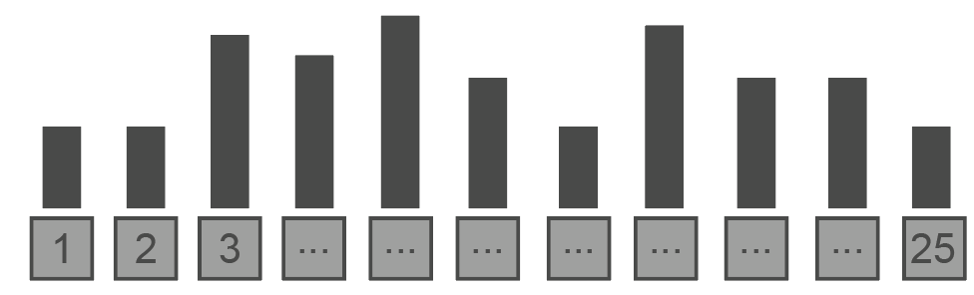
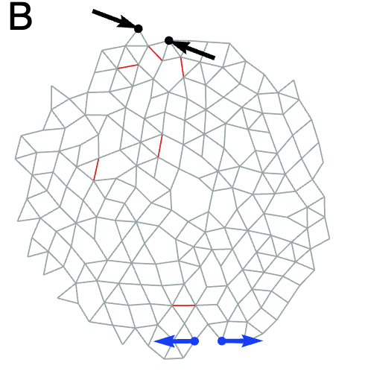


Many systems naturally realize Hebbian learning algorithms.
with neurons
with mechanics
with molecules
Conc.
Firing rate
Strain
Liu and Nagel lab
Fire together,
Wire together
Stretched bonds weaken
Run into each together,
Grow to like each other

Slide 3
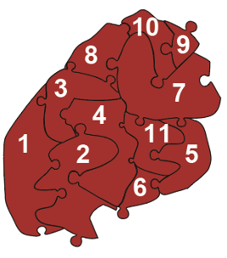
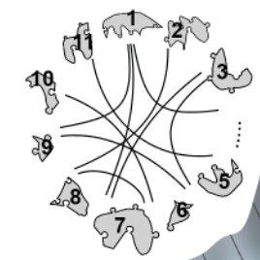
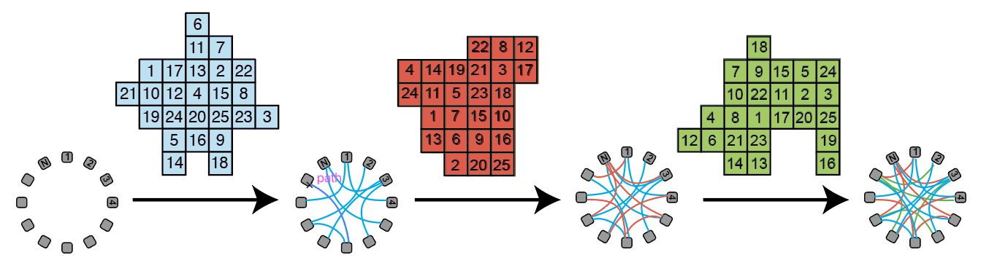
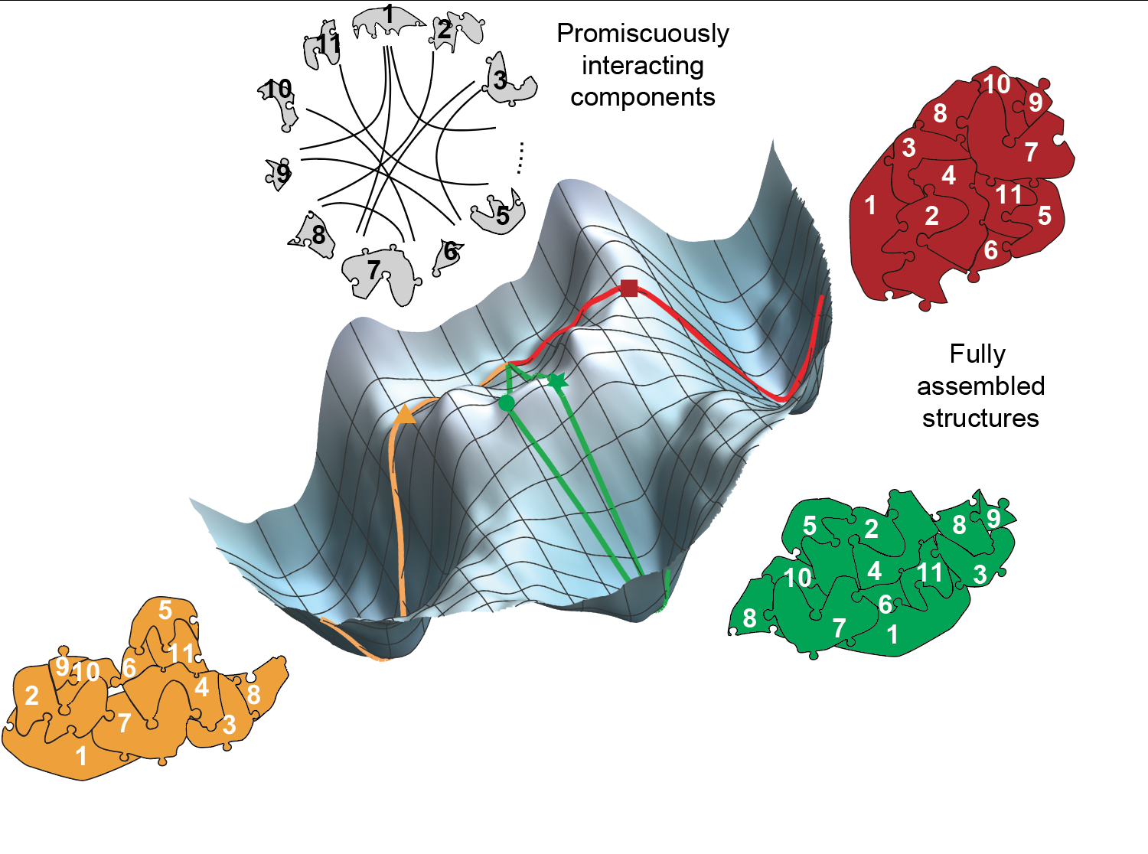
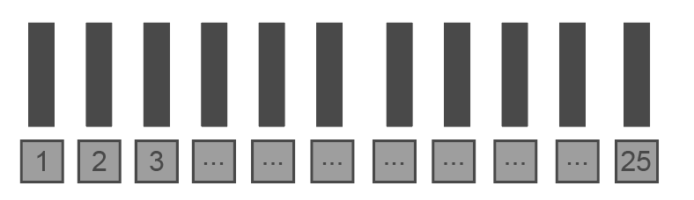
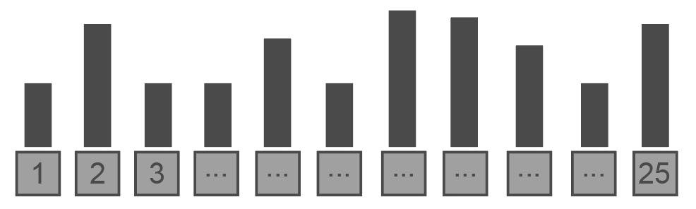
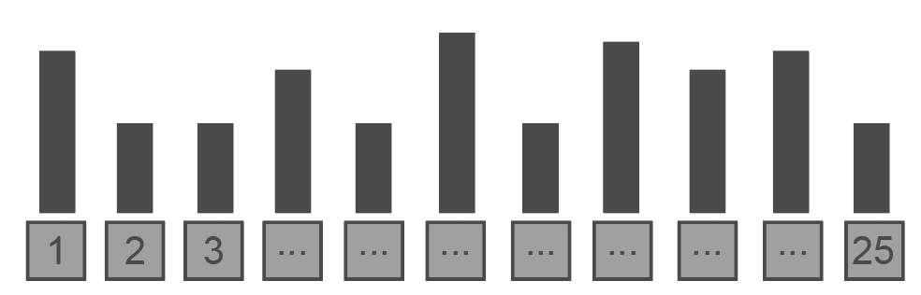
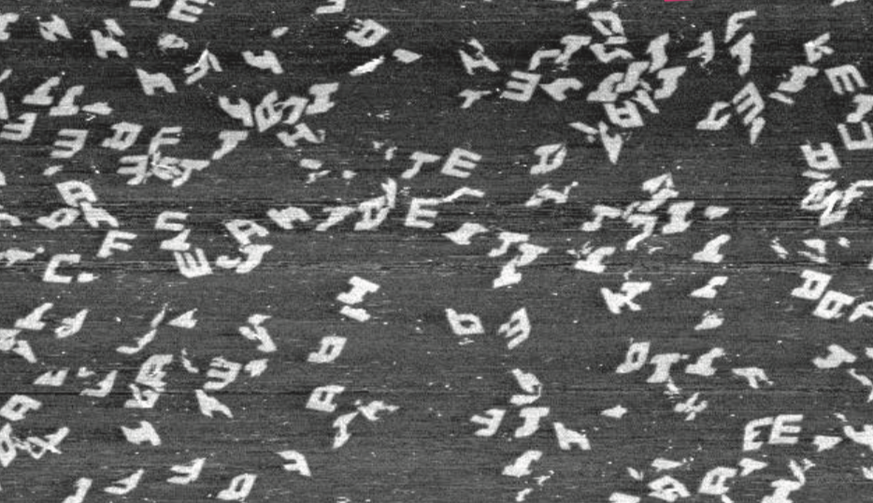
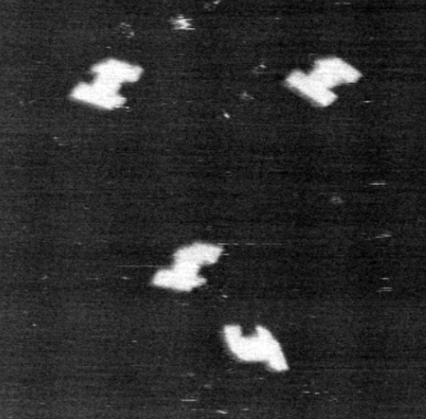
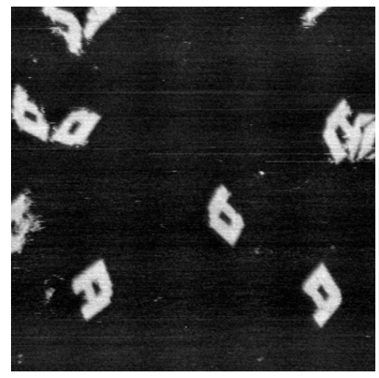
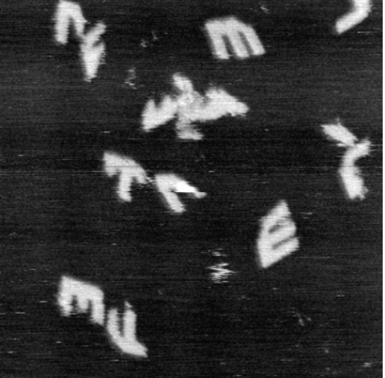
Molecules trained with Hebbian rules have the capacity for pattern recognition.
Murugan et al, PNAS 2015
Evans et al, arXiv 2022

Slide 4
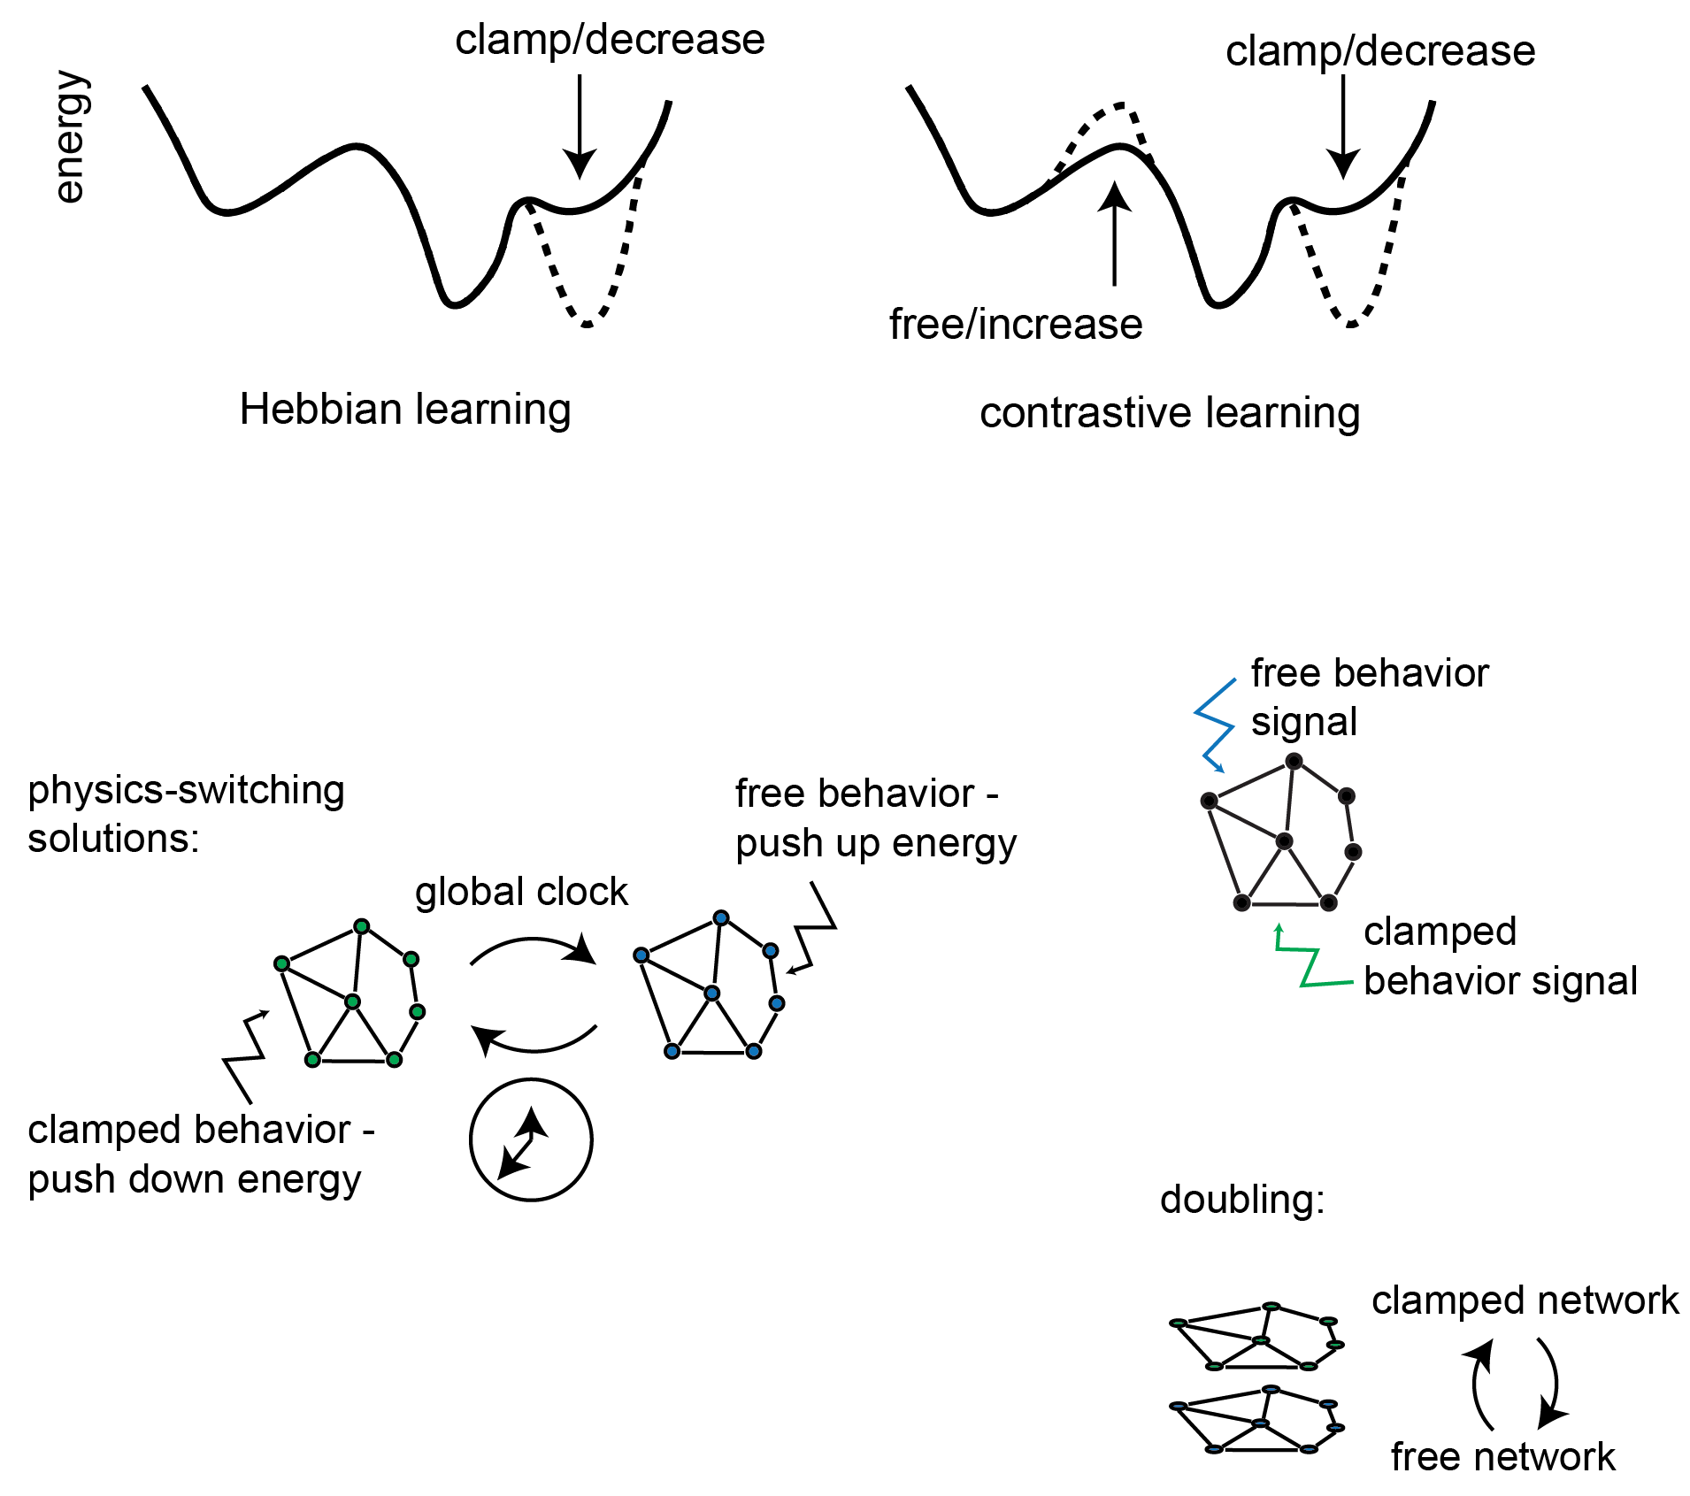
Many systems naturally realize Hebbian learning algorithms because it involves lowering the energy of desired (clamped) behaviors.
More powerful algorithms are contrastive:
lower the energy of clamped behaviors,
raise the energy of free behaviors.

Slide 5
How to do this? Alternate between Hebbian and anti-Hebbian physics.
Problem: big swings in weight updates, especially near target state.

Slide 6
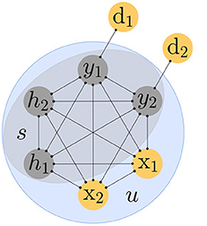
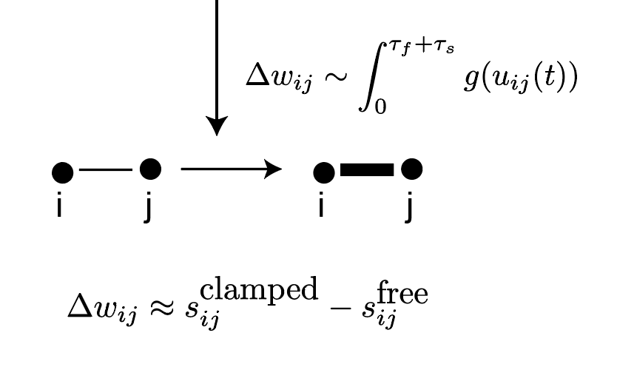
Contrastive learning actually requires us to take a paired difference.
Free state
Clamped state
Clamp desired output
Learning based on the contrast:
Send input
Send input
time
Contrastive Hebbian learning: Movellan (1991)
Contrastive Divergence: Hinton (2002)
Equilibrium Propagation:
Scellier, Bengio + others 2017 - 2023

Slide 7
Fundamental challenge: must compare paired good/bad states over time.
How can we do this in a physical system?

Slide 8
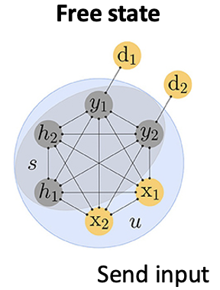
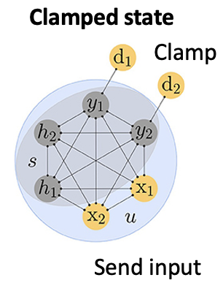
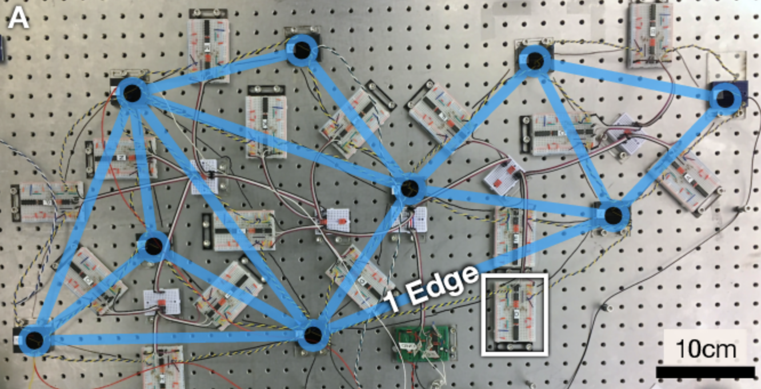
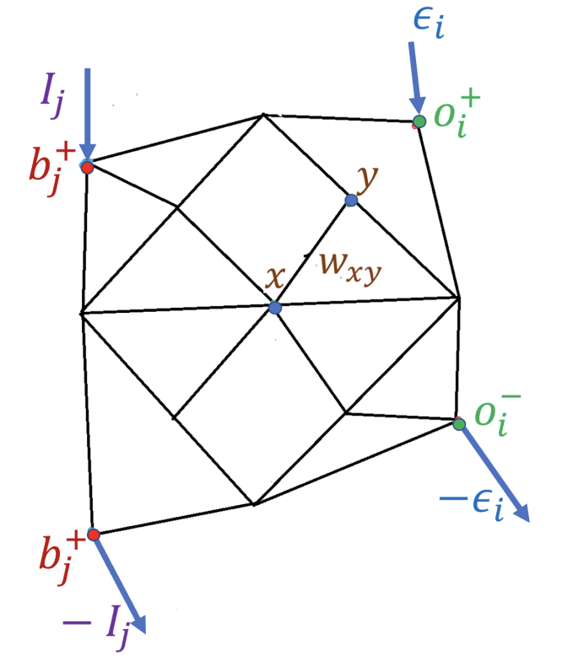
Fundamental challenge: must compare paired good/bad states over time.
Solutions:
Explicit memory
Coupled learning
Multi-mechanism learning
Two copies of the system
Two different kinds of signals
for free and clamped
Update
Write down
s-free
Write down
s-clamped
Dillavou et al, PRA 2022
Anisetti et al, PRR 2023
For ‘natural’ physical learning:
No explicit memory of free and clamped states
All in one: Direct update of parameters without storage

Slide 9
Claim: there is a common physical process that allows for contrastive parameter updates without explicit storage.
Specifically, non-equilibrium feedback control combined with Hebbian remodeling leads to
contrastive learning in physical systems.

Slide 10
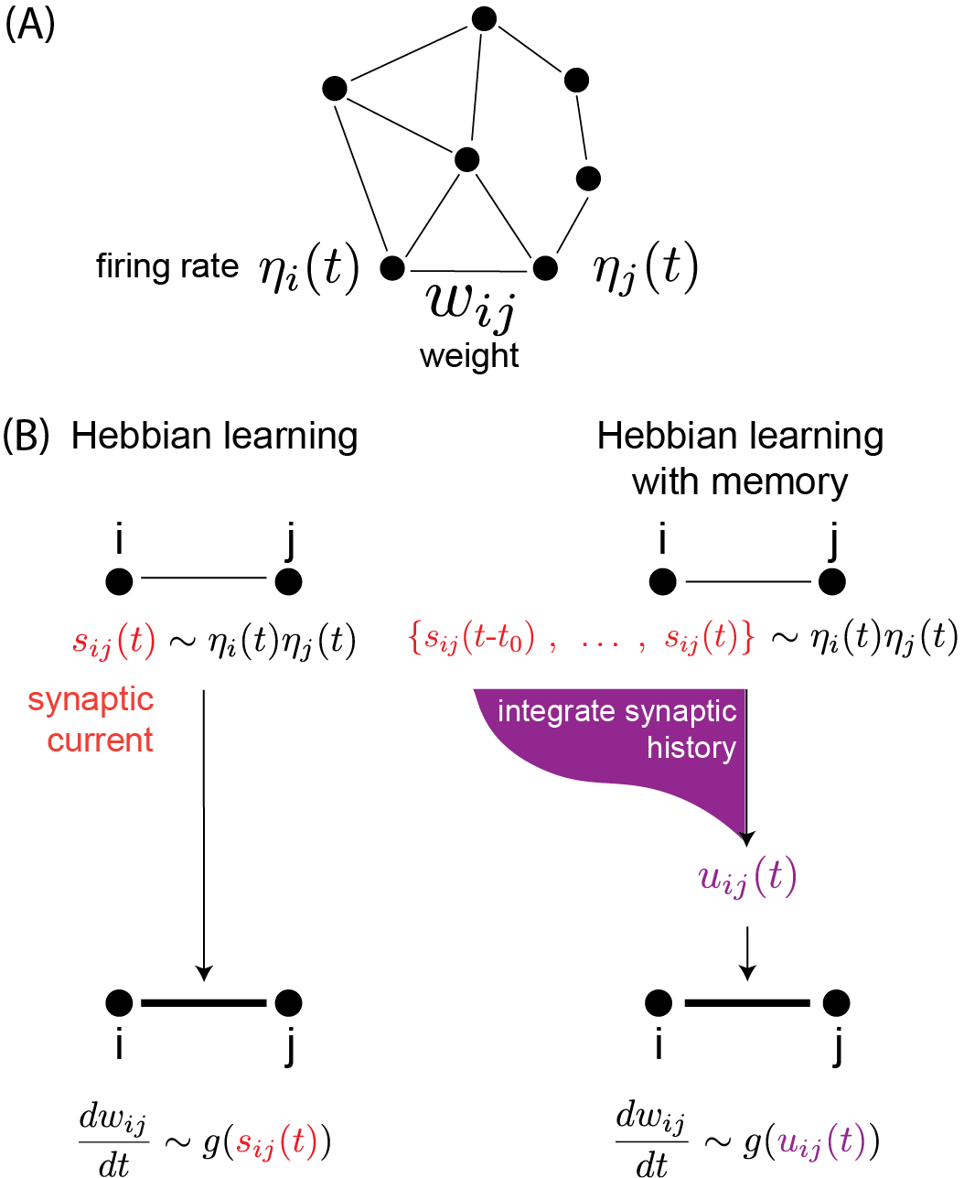
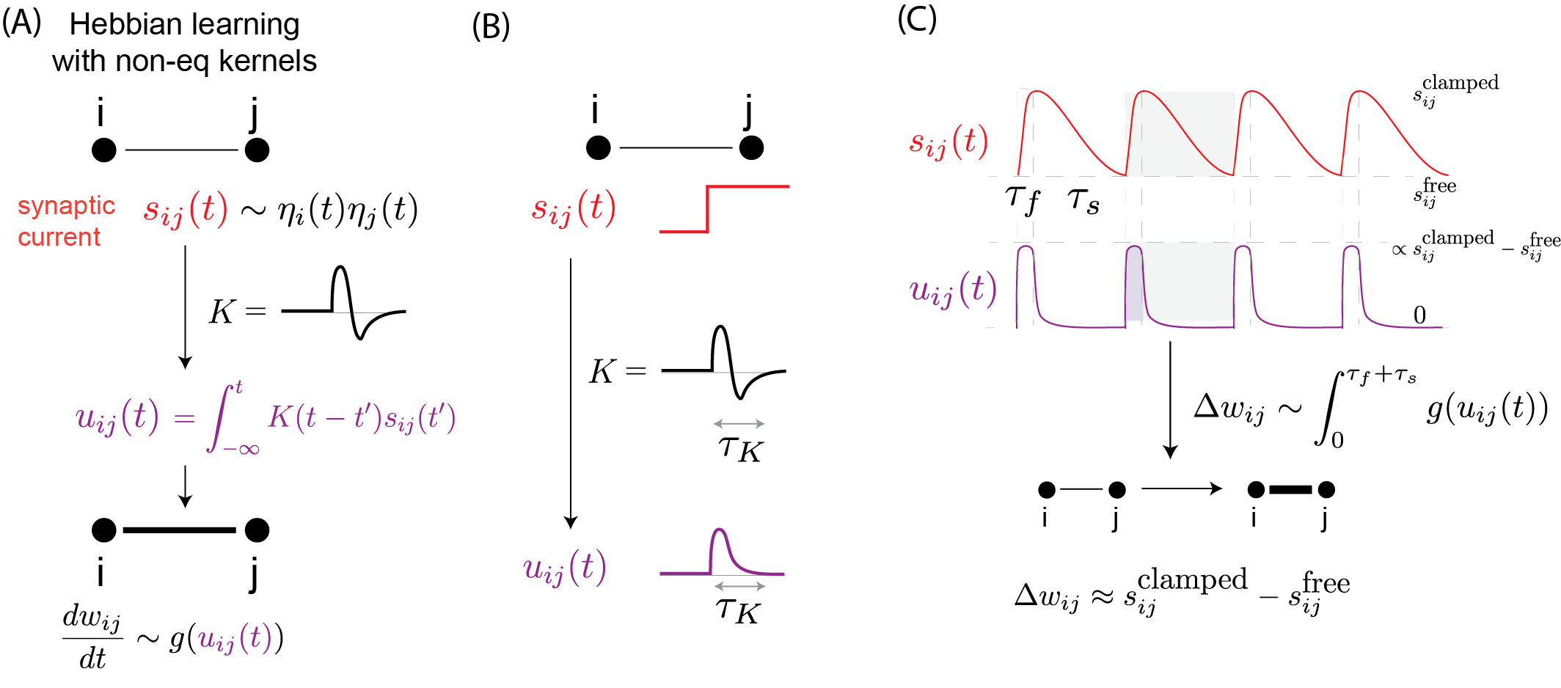
Memory kernels from dissipative processes solve the comparison challenge.

Slide 11
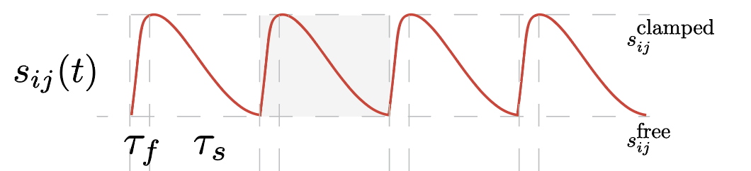
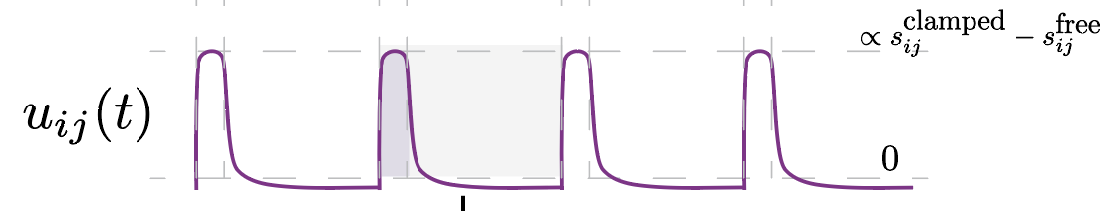
Memory kernels from dissipative processes solve the comparison challenge.
contrastive
updates!

Slide 12
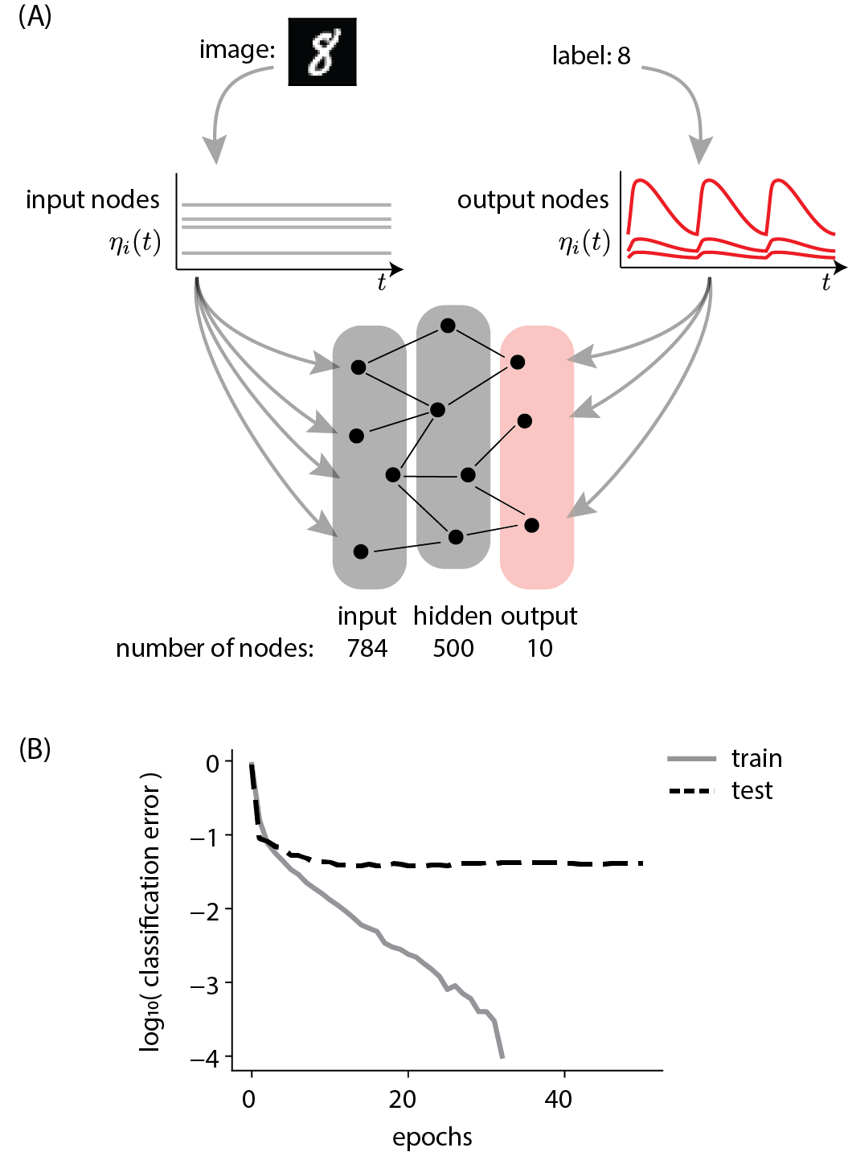
Non-equilibrium memory allows for classification of MNIST.
Scellier + Bengio (2017)
Notes:
Update from 8/16/23

Slide 13
Non-equilibrium memory allows for classification of MNIST.
Scellier + Bengio (2017)
Notes:
Update from 8/16/23

Slide 14
Question: What are the limitations?

Slide 15
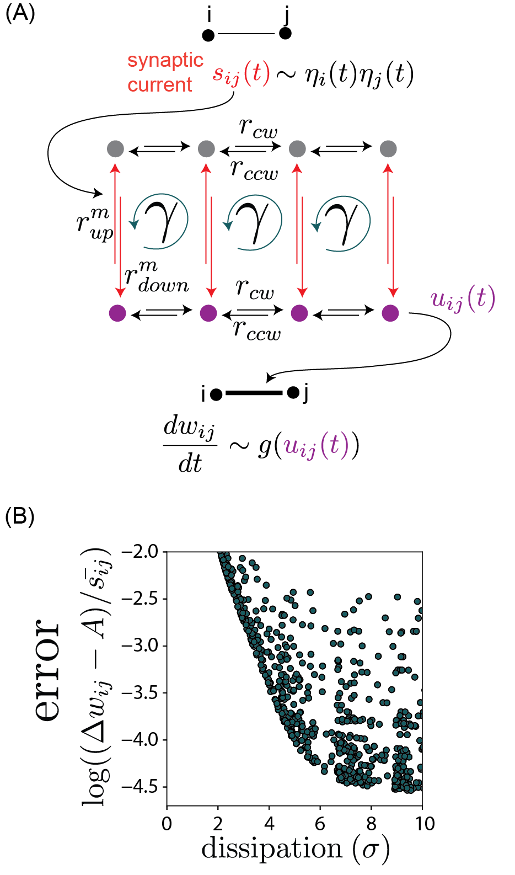
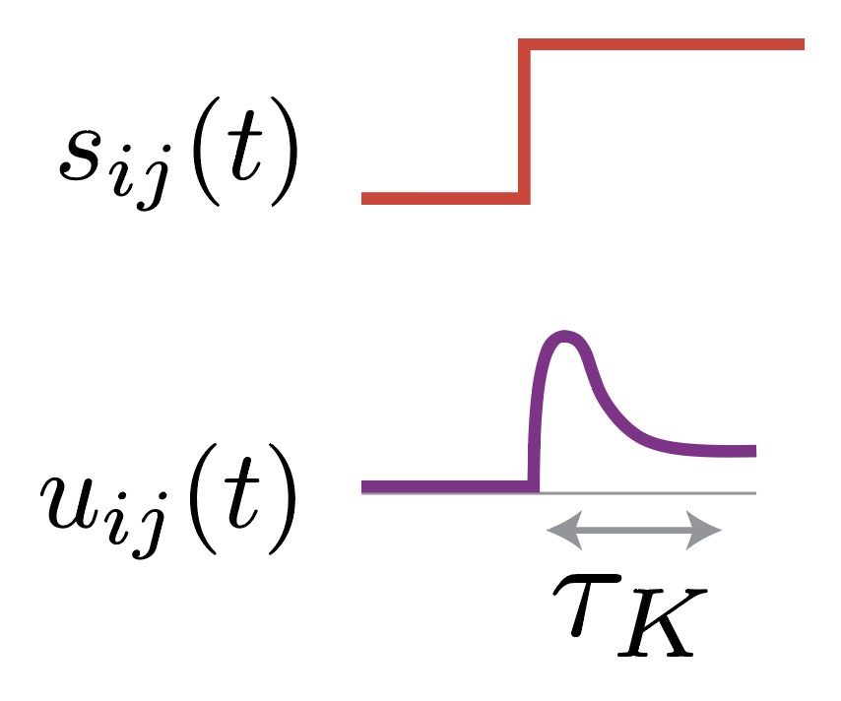
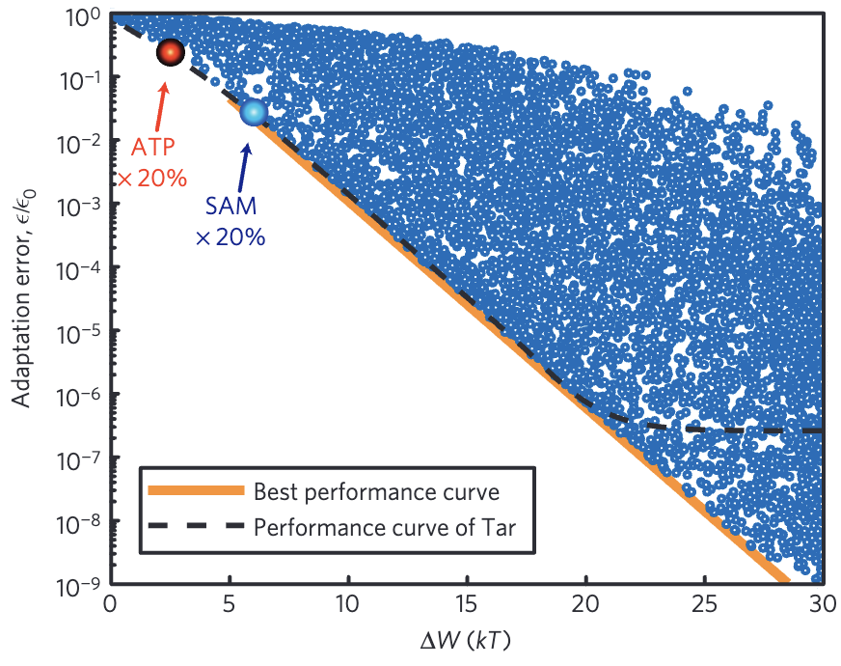
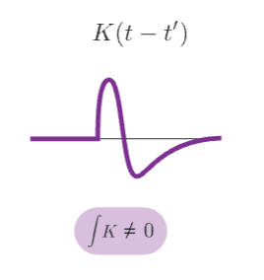
Landauer sets a dissipation limit for contrastive learning.
area under kernel
energy cost
error in contrastive update
Lan, Sartori et al, Nat. Phys 2012
Explicit memory problem solved by computing derivatives => requires `forgetting’
=> not possible at equilibrium!
energy cost

Slide 16
Question: What are the key ingredients necessary to make this work?

Slide 17
system remodeling/
Hebbian learning
+
non-equilibrium feedback control

Slide 18
A simple mechanism for contrastive learning in mechano-chemical networks.
Hebbian learning
Contrastive learning

Slide 19
Summary
Why do we like this? All-in-one:
free state computation,
clamped state computation,
difference between the two,
parameter updates,
without explicit memory storage, from a ubiquitous physical process.
Furthermore, allows us to compute fundamental dissipation bounds.

Slide 20


Thank you!
https://arxiv.org/abs/2312.17723
falkma@uchicago.edu
Adam Strupp
Ben Scellier
Arvind Murugan

